Slide 1
Threads-III
Synchronization in java
K Krishna Priya

Slide 2
Synchronization
Synchronization in java is the capability to control the access of multiple threads to any shared resource.
In the Multithreading concept, multiple threads try to access the shared resources at a time to produce inconsistent results.
The synchronization is necessary for reliable communication between threads.
Why we use Synchronization
Synchronization helps in preventing thread interference.
Synchronization helps to prevent concurrency problems.

Slide 3
Types of Synchronization
Synchronization is classified into two types
Process Synchronization
Thread Synchronization
Process Synchronization:
The process is nothing but a program under execution. It runs independently isolated from another process. The resources like memory and CPU time, etc. are allocated to the process by the operation System.

Slide 4
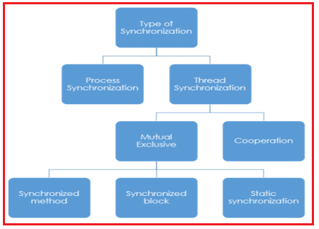

Slide 5
Thread Synchronization:
Thread synchronization is two types, they are:
1.Mutual Exclusive:
A Mutex or Mutual Exclusive helps only one thread to access the shared resources. It won’t allow the accessing of shared resources at a time. It can be achieved in the following ways.
Synchronized Method
Synchronized block
Static Synchronization
2. Cooperation (Inter Thread Communication in java)

Slide 6
Lock Concept in Java
Synchronization Mechanism developed by using the synchronized keyword in java language.
It is built on top of the locking mechanism, this locking mechanism is taken care of by Java Virtual Machine (JVM).
The synchronized keyword is only applicable for methods and blocks, it can’t apply to classes and variables.
Synchronized keyword in java creates a block of code is known as a critical section.
To enter into the critical section thread needs to obtain the corresponding object’s lock.

Slide 7
Java Synchronized Method
If we use the Synchronized keywords in any method then that method is Synchronized Method.
It is used to lock an object for any shared resources.
The object gets the lock when the synchronized method is called.
The lock won’t be released until the thread completes its function.
Syntax:
Acess_modifiers synchronized return_type method_name (Method_Parameters) {
// Code of the Method.
}

Slide 8
Cont…
Here we used synchronized keywords. It helps to execute a single thread at a time.
It is not allowing another thread to execute until the first one is completed, after completion of the first thread it allowed the second thread.
Now we can see the output correctly the powers 5 and 8 from n¹ to n⁵. Thread-0 completed then only thread-1 begin.

Slide 9
Synchronized Block
Suppose you don’t want to synchronize the entire method, you want to synchronize few lines of code in the method, then a synchronized block helps to synchronize those few lines of code.
It will take the object as a parameter. It will work the same as Synchronized Method.
In the case of synchronized method lock accessed is on the method but in the case of synchronized block lock accessed is on the object.
Note: We can develop any number of synchronized blocks in a method.

Slide 10
Static Synchronization
In java, every object has a single lock (monitor) associated with it. The thread which is entering into synchronized method or synchronized block will get that lock, all other threads which are remaining to use the shared resources have to wait for the completion of the first thread and release of the lock.
Suppose in the case of where we have more than one object, in this case, two separate threads will acquire the locks and enter into a synchronized block or synchronized method with a separate lock for each object at the same time. To avoid this, we will use static synchronization.
In this, we will place synchronized keywords before the static method. In static synchronization, lock access is on the class not on object and Method.

Slide 11
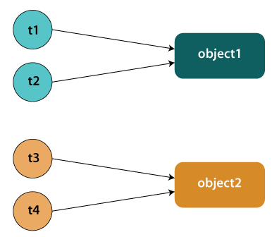
Static Synchronization

Slide 12
Syntax:
synchronized static return_type method_name (Parameters) {
//code
}
Or
synchronized static return_type method_name (Class_name.class) {
//code
}

Slide 13

Deadlock in Java
Deadlock in Java is a part of multithreading.
Deadlock can occur in a situation when a thread is waiting for an object lock, that is acquired by another thread and second thread is waiting for an object lock that is acquired by first thread.
Since, both threads are waiting for each other to release the lock, the condition is called deadlock.

Slide 14
How to Avoid Deadlock in Java?
Deadlocks cannot be completely resolved. But we can avoid them by following basic rules mentioned below:
Avoid Nested Locks: We must avoid giving locks to multiple threads, this is the main reason for a deadlock condition. It normally happens when you give locks to multiple threads.
Avoid Unnecessary Locks: The locks should be given to the important threads. Giving locks to the unnecessary threads that cause the deadlock condition.
Using Thread Join: A deadlock usually happens when one thread is waiting for the other to finish. In this case, we can use join with a maximum time that a thread will take.

Slide 15
Inter – Thread Communication
Inter – Thread communication or cooperation is a communication of two or more threads with each other. It can be done by using the following methods.
wait()
notify()
notifyAll()

Slide 16
Why we need Inter – Thread Communication?
There is a situation on the thread that keeps on checking some conditions repeatedly, once that condition satisfies thread moves with the appropriate action.
This situation is known as polling. This is a wastage of CPU time, to reduce the wastage of CPU time due to polling, java uses Inter – Thread Communication Mechanism.
wait(), notify(), notifyAll() methods must be called within a synchronized method or block otherwise program will compile but when you run it, it will throw illegal monitor State Exception.

Slide 17
Wait() and notify() Method
wait () Method
It causes the current thread to place itself into the waiting stage until another thread invokes the notify() method or notifyAll() method for this object.
notify () Method
This method wakes up a single thread called wait () on the same object. If there is more than one thread that is waiting on this same object, then any one of them arbitrarily chosen to be awakened. Here awakened thread will not able to proceed until the current thread release lock. If any threads are trying to get the lock on this object then the awakened thread will also compete with them in the usual manner.
Syntax:
public final void notify()

Slide 18
notify All() Method
Rather than a single thread, it will wake up all the threads waiting on this object monitor. The awakened thread will not able to proceed until the current thread releases the lock. Again, these awakened threads need to compete with all other threads which are trying to get the lock on this object.
Syntax:
public final void notifyAll()

Slide 19
Producer-Consumer solution using threads in Java
In computing, the producer-consumer problem (also known as the bounded-buffer problem) is a classic example of a multi-process synchronization problem. The problem describes two processes, the producer and the consumer, which share a common, fixed-size buffer used as a queue.
The producer’s job is to generate data, put it into the buffer, and start again.
At the same time, the consumer is consuming the data (i.e. removing it from the buffer), one piece at a time.

Slide 20
Cont..
Problem
To make sure that the producer won’t try to add data into the buffer if it’s full and that the consumer won’t try to remove data from an empty buffer.
Solution
The producer is to either go to sleep or discard data if the buffer is full. The next time the consumer removes an item from the buffer, it notifies the producer, who starts to fill the buffer again.
In the same way, the consumer can go to sleep if it finds the buffer to be empty. The next time the producer puts data into the buffer, it wakes up the sleeping consumer.
An inadequate solution could result in a deadlock where both processes are waiting to be awakened.

Slide 21
In both the methods, we use notify at the end of all statements. The reason is simple, once you have something in list, you can have the consumer thread consume it, or if you have consumed something, you can have the producer produce something.

